Slide 1
Cmder, Gulp & Scss
New Tool – by AJ

Slide 2

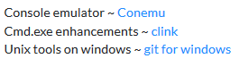
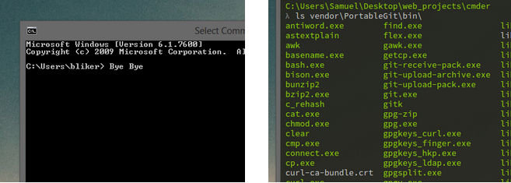
Enhance the Command Prompt using Cmder

Slide 3
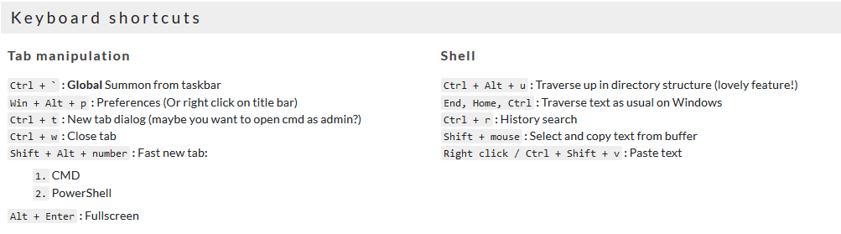
Enhance the Command Prompt using Cmder

Slide 4
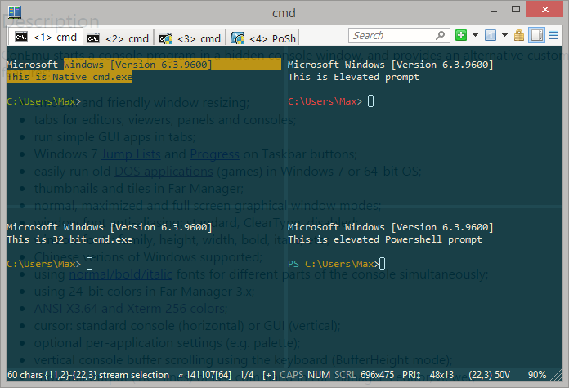
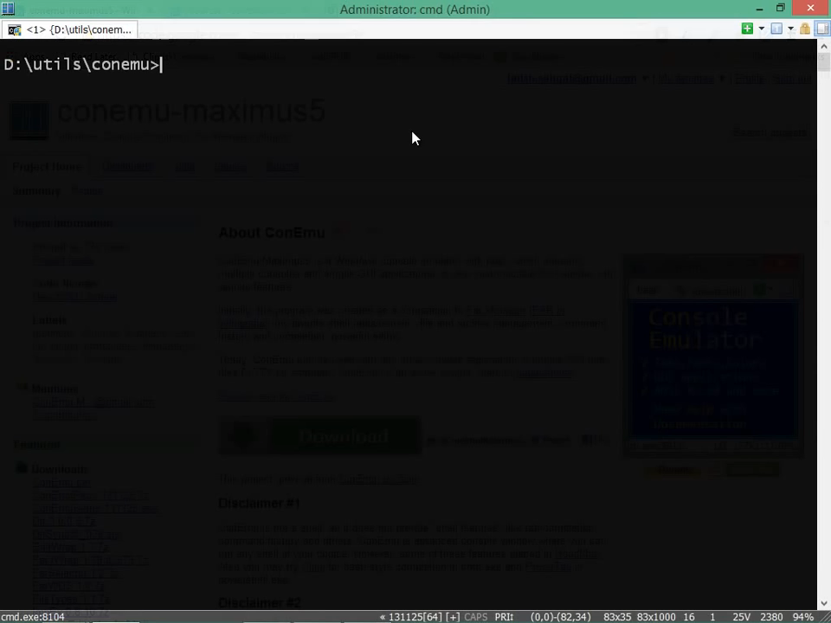
ConEmu

Slide 5
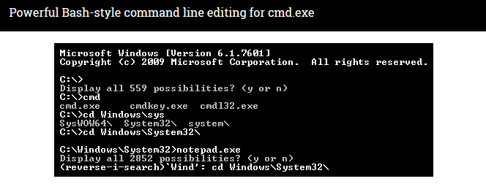
CLink
Overview
Clink combines the native Windows shell cmd.exe with the powerful command line editing features of the GNU Readline library, which provides rich completion, history, and line-editing capabilities. Readline is best known for its use in the well-known Unix shell Bash, the standard shell for Mac OS X and many Linux distributions.

Slide 6
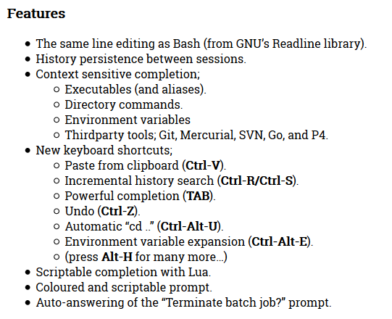
CLink

Slide 7
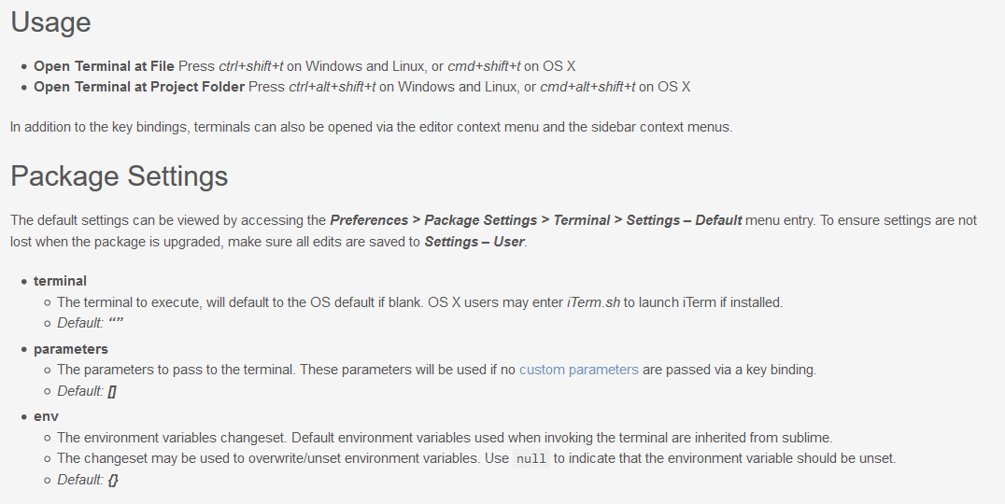
Configure Cmder

Slide 8
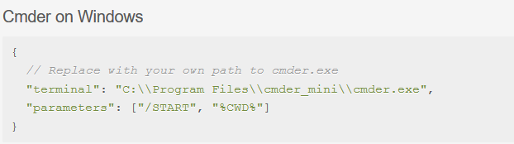
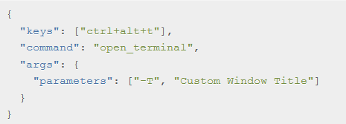
Configure Cmder

Slide 9
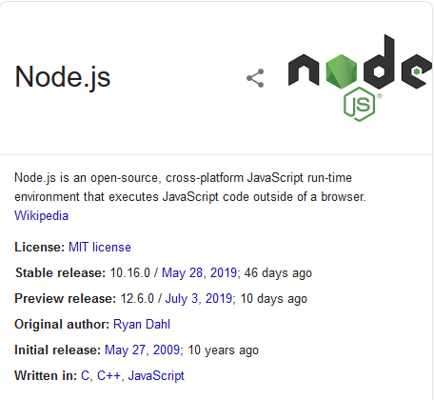
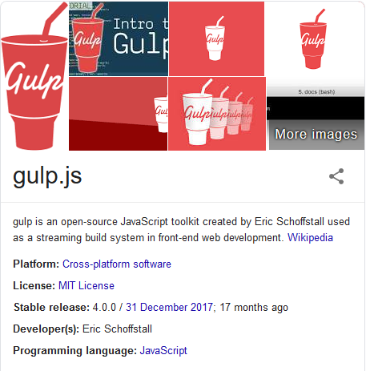
Install Node

Slide 10
Install Node
Node -v
Npm -v
Npm init
Npm install gulp-cli -g
Npm install gulp -D
Gulp -v
Npm install --save-dev gulp-sass browser-sync

Slide 11
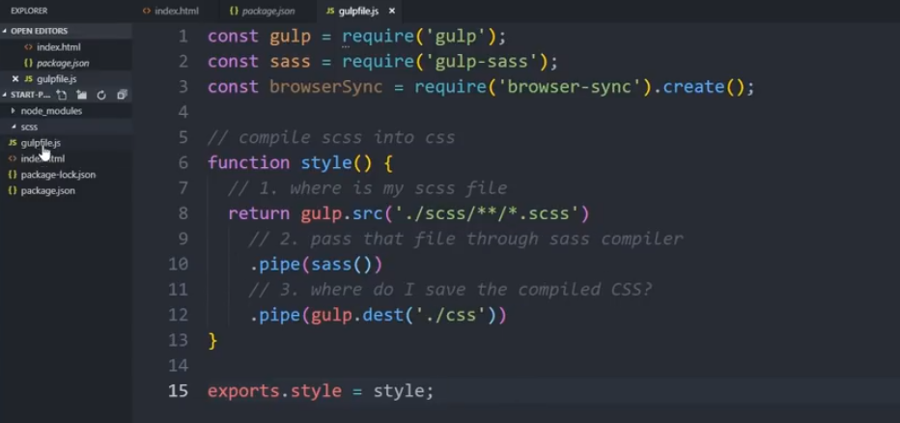
Create gulpfile.js

Slide 12
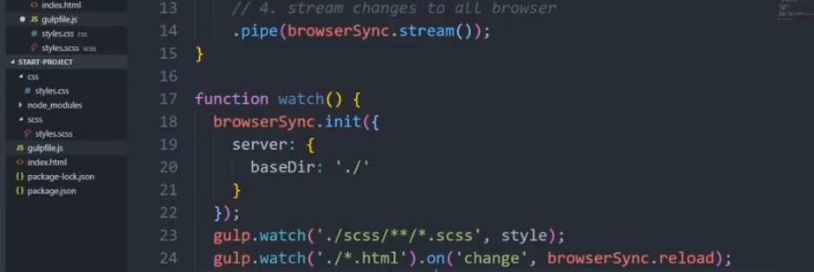
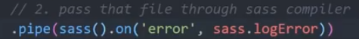
Create SCSS Folder and .SCSS file Inside
Gulp style

Slide 13
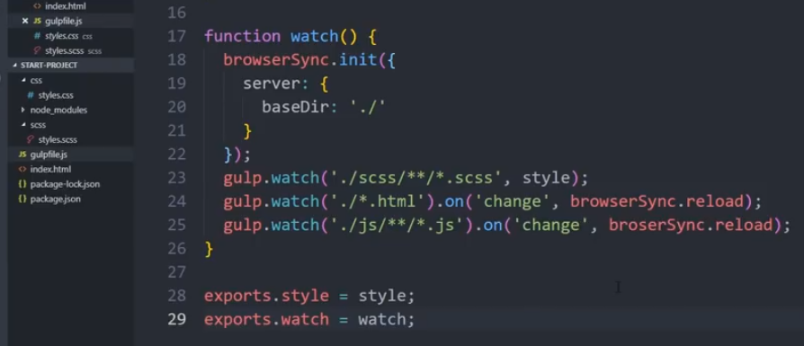
Page 2
Gulp Watch

Slide 14
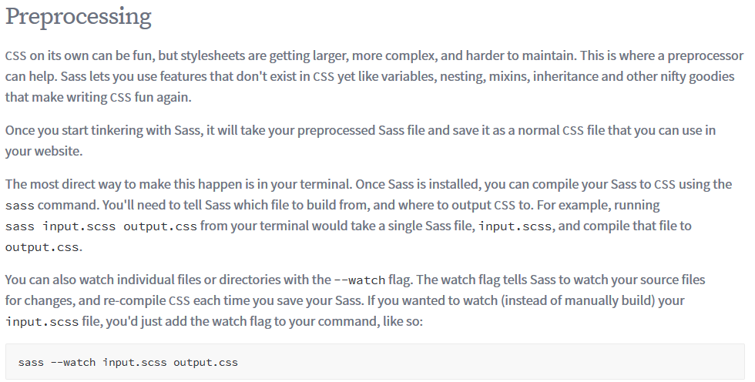
SASS / SCSS

Slide 15
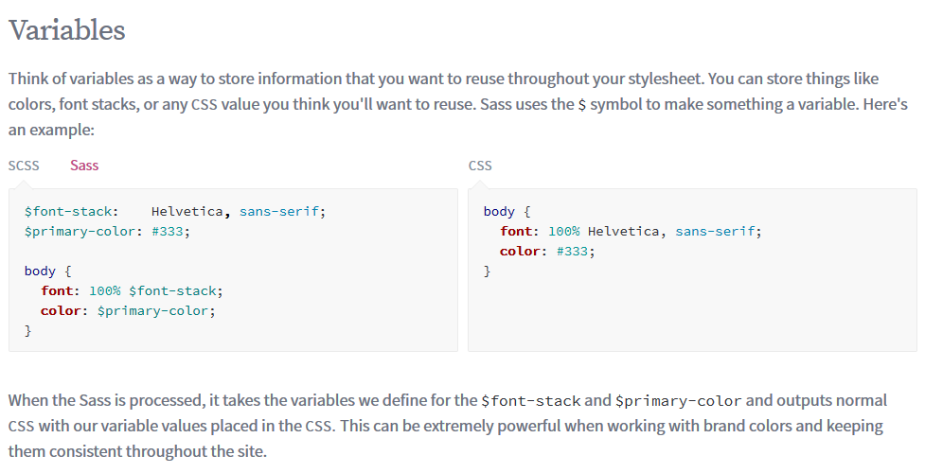
SASS / SCSS

Slide 16
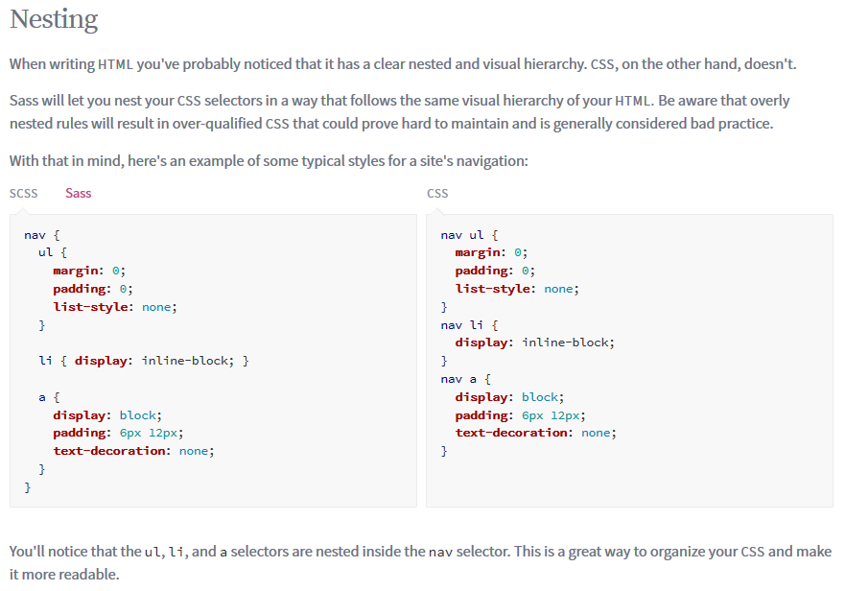
SASS / SCSS

Slide 17
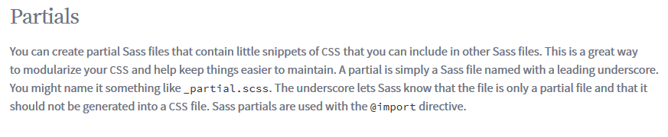
SASS / SCSS

Slide 18
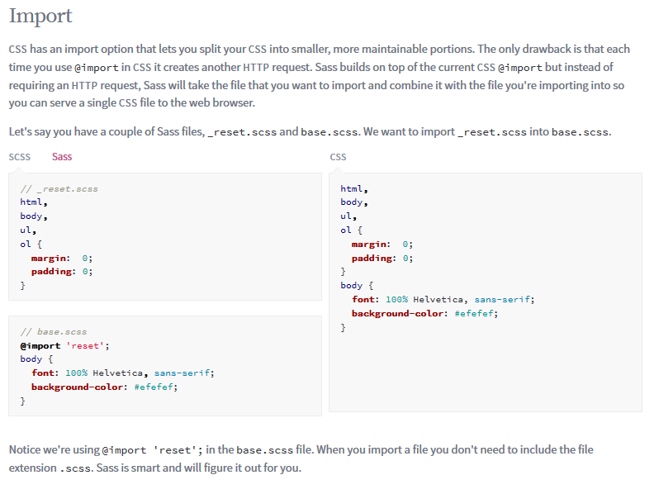
SASS / SCSS

Slide 19
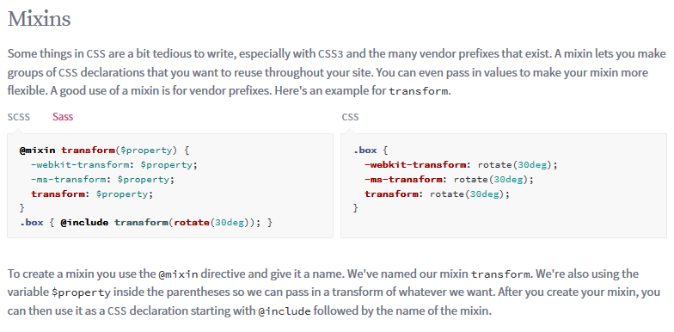
SASS / SCSS

Slide 20
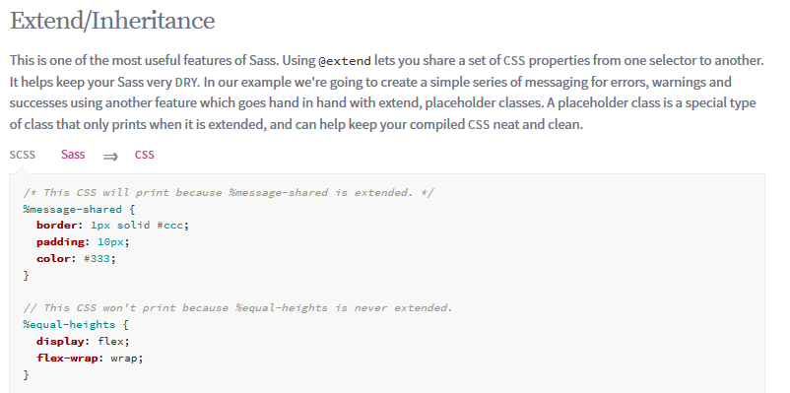
SASS / SCSS

Slide 21
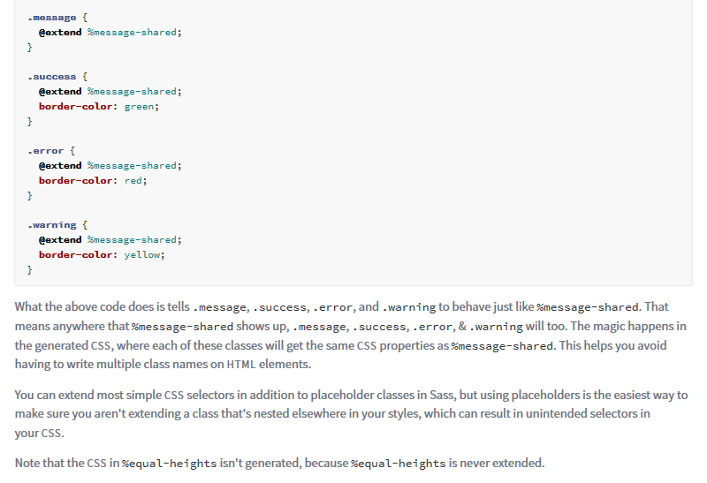
SASS / SCSS

Slide 22
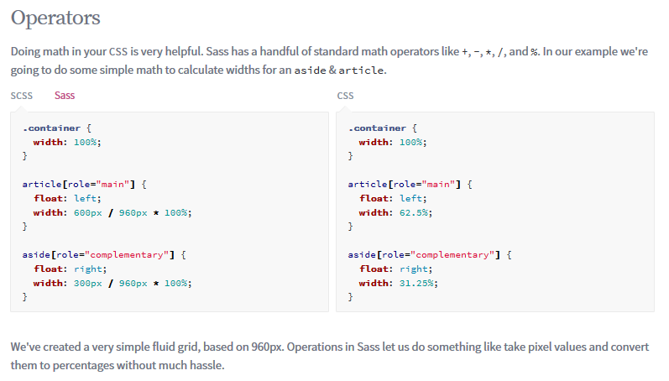
SASS / SCSS

